Slide 1
React- Events and States Laiba Imran

Slide 2
State as a Snapshot
State variables might look like regular JavaScript variables that you can read and write to.
However, state behaves more like a snapshot.
When you read a state variable, you're getting a snapshot of its value at a specific point in time (at the moment of that render).
Setting it does not change the state variable you already have, but instead triggers a re-render.

Slide 3
State as a Snapshot
When React re-renders a component:
1. React calls your function again.
2. Your function returns a new JSX snapshot.
3. React then updates the screen to match the snapshot your
function returned.
React will re-render the component with the updated state value, and only then will you see the change reflected.
React’s state batching and snapshot approach helps keep the UI predictable and efficient, particularly in larger apps where multiple state changes may occur at once.

Slide 4

Snapshots
App.js
import { useState } from 'react';
export default function Counter() {
const [number, setNumber] = useState(0);
return (
<>
<h1>{number}</h1>
<button onClick={() => {
setNumber(number + 1);
setNumber(number + 1);
setNumber(number + 1);
}}>+3</button>
</>
)
}
Click to see the results of above code
https://codesandbox.io/p/sandbox/tty55g?file=%2Fsrc%2FApp.js%3A1%2C1-16%2C2

Slide 5
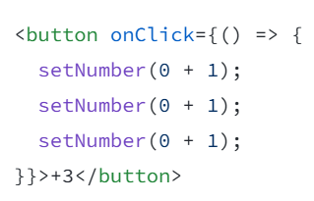
State as a Snapshot
Batching: React waits until all code in the event handlers has run before processing your state updates.
This is why the re-render only happens after all these setNumber() calls.
Notes:
A waiter doesn’t run to the kitchen at the mention of your first dish! Instead, they let you finish your order, let you make changes to it, and even take orders from other people at the table.

Slide 6
Snapshots
App.js
import { useState } from 'react';
export default function Counter() {
const [number, setNumber] = useState(0);
return (
<>
<h1>{number}</h1>
<button onClick={() => {
setNumber(number + 5);
alert(number);
}}>+5</button>
</>
)
}
🤔
Click to see the results of above code
https://codesandbox.io/p/sandbox/ffhp6h?file=%2Fsrc%2FApp.js%3A1%2C1-15%2C2

Slide 7
Updating the same state multiple times before the next render
It is an uncommon use case, but if you would like to update the same state variable multiple times before the next render, instead of passing the next state value like setNumber(number + 1), you can pass a function that calculates the next state based on the previous one in the queue, like setNumber(n => n + 1).
To update based on the latest state value each time, you can use the functional form of setNumber. This approach updates state based on the previous state, which avoids the issue of each update referring to the initial snapshot.
n => n + 1 is called an updater function.

Slide 8

Updating State within render
App.js
import { useState } from 'react';
export default function Counter() {
const [number, setNumber] = useState(0);
return (
<>
<h1>{number}</h1>
<button onClick={() => {
setNumber(n => n + 1);
setNumber(n => n + 1);
setNumber(n => n + 1);
}}>+3</button>
</>
)
}
Click to see the results of above code
https://codesandbox.io/p/sandbox/xcsmmf?file=%2Fsrc%2FApp.js%3A1%2C1-16%2C2

Slide 9
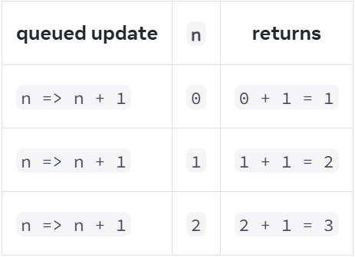
State as a Snapshot
Batching: React waits until all code in the event handlers has run before processing your state updates.
This is why the re-render only happens after all these setNumber() calls.

Slide 10
Updating State within render
App.js
import { useState } from 'react';
export default function Counter() {
const [number, setNumber] = useState(0);
return (
<>
<h1>{number}</h1>
<button onClick={() => {
setNumber(number + 5);
setNumber(n => n + 1);
}}>Increase the number</button>
</>
)
}
🤔
Click to see the results of above code
https://codesandbox.io/p/sandbox/4zryt5?file=%2Fsrc%2FApp.js
Notes:
setNumber(42);

Slide 11
Event Propagation

Slide 12
Event Propagation
App.js
export default function Toolbar() {
return (
<div className="Toolbar" onClick={() => {
alert('You clicked on the toolbar!');
}}>
<button onClick={() => alert('Playing!')}>
Play Movie
</button>
<button onClick={() => alert('Uploading!')}>
Upload Image
</button>
</div>
);
}
Click to see the results of above code
https://codesandbox.io/p/sandbox/qqwck7?file=%2Fsrc%2FApp.js%3A1%2C1-15%2C1

Slide 13
Stop Event Propagation
App.js
function Button({ onClick, children }) {
return (
<button onClick={e => {
e.stopPropagation();
onClick();
}}> {children} </button>
);}
export default function Toolbar() {
return (
<div className="Toolbar" onClick={() => {
alert('You clicked on the toolbar!');
}}>
<Button onClick={() => alert('Playing!')}>
Play Movie
</Button>
<Button onClick={() => alert('Uploading!')}>
Upload Image
</Button>
</div>
);}
Click to see the results of above code
https://codesandbox.io/p/sandbox/ty644j?file=%2Fsrc%2FApp.js%3A1%2C1-26%2C1

Slide 14
Prevent Default Behavior
App.js
export default function Signup() {
return (
<form onSubmit={e => {
e.preventDefault();
alert('Submitting!');
}}>
<input />
<button>Send</button>
</form>
);
}
Click to see the results of above code
https://codesandbox.io/p/sandbox/k4hpgf?file=%2Fsrc%2FApp.js

Slide 15
Practice
Practice these 🙏:
https://react.dev/learn/state-as-a-snapshot#challenges
https://react.dev/learn/queueing-a-series-of-state-updates#challenges
https://react.dev/learn/responding-to-events#challenges

Slide 16
Resources
Go over
https://react.dev/learn/adding-interactivity
https://react.dev/reference/react-dom/components

